Slide 1
Evolving Clinical Resistance and Treatment Strategies for Novel β-lactam Agents against Pseudomonas aeruginosa
Ryan K. Shields, PharmD, MS
University of Pittsburgh
Associate Professor of Medicine
Co-Director, Antibiotic Management Program, UPMC
Co-Director, Center for Innovative Antimicrobial Therapy, Pitt

Slide 2


Disclosures
Advisor/consultant: Cidara, Entasis, GlaxoSmithKline, Menarini, Melinta, Merck, Pfizer, Roche, Shionogi, and Venatorx
Research funding: Merck, Melinta, Roche, Shionogi, and Venatorx
NIH - NIAID
Thank you to ARLG for the opportunity to present today!

Slide 3
Presentation outline
Brief review of how P. aeruginosa evade killing by β-lactam antibiotics
How well do the newest β-lactams expand our armamentarium?
Emerging phenotypes with interesting genotypes clinicians need to know
Cross-resistance and collateral susceptibility mechanisms that impact patient care
Looking forward – what is the preferred agent for MDR P. aeruginosa?
Is one new agent better than another?
Do we need to be more aggressive in using newer β-lactams?

Slide 4
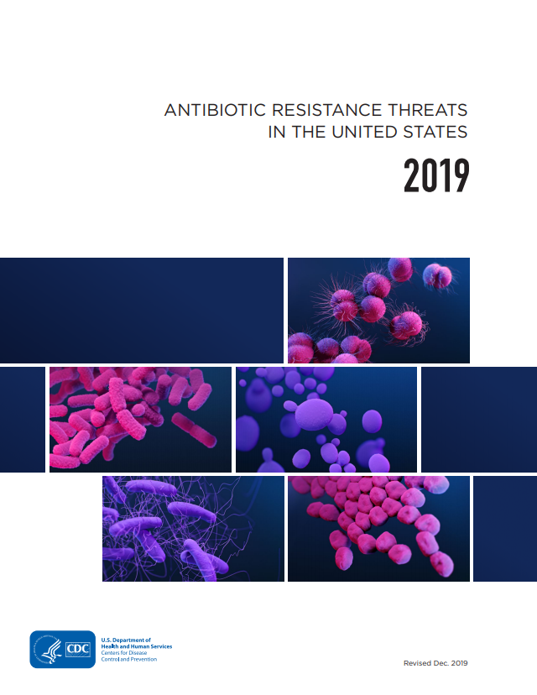

AMR Threats in the U.S. (and worldwide)
Each year in the U.S., AMR pathogens account for:
>2,868,700 infections
>35,900 deaths
Urgent
Serious
Centers for Disease Control and Prevention. Available at: https://www.cdc.gov/drugresistance/Biggest-Threats.html#carp

Slide 5
β-lactams: In vitro spectrum
 | Meropenem | Ceftolozane-tazobactam | Ceftazidime-avibactam | Meropenem- vaborbactam | Imipenem- relebactam | Cefiderocol
ESBL |  |  |  |  |  | 
CTX-M |  |  |  |  |  | 
CRE | ✗ | ✗ |  |  |  | 
KPC | ✗ | ✗ |  |  |  | 
MBL | ✗ | ✗ | ✗ | ✗ | ✗ | 
OXA-48 | ± | ± |  | ✗ | ✗ | 
P. aeruginosa | ± |  |  |  |  | 
CEFTAZ-R | ± |  |  | ± |  | 
MERO-R | ✗ |  |  | ✗ |  | 
A. baumannii | ✗ | ✗ | ✗ | ✗ | ✗ | 
XDR | ✗ | ✗ | ✗ | ✗ | ✗ | 
✗ = Resistant; ± Variable activity;  Susceptible

Slide 6
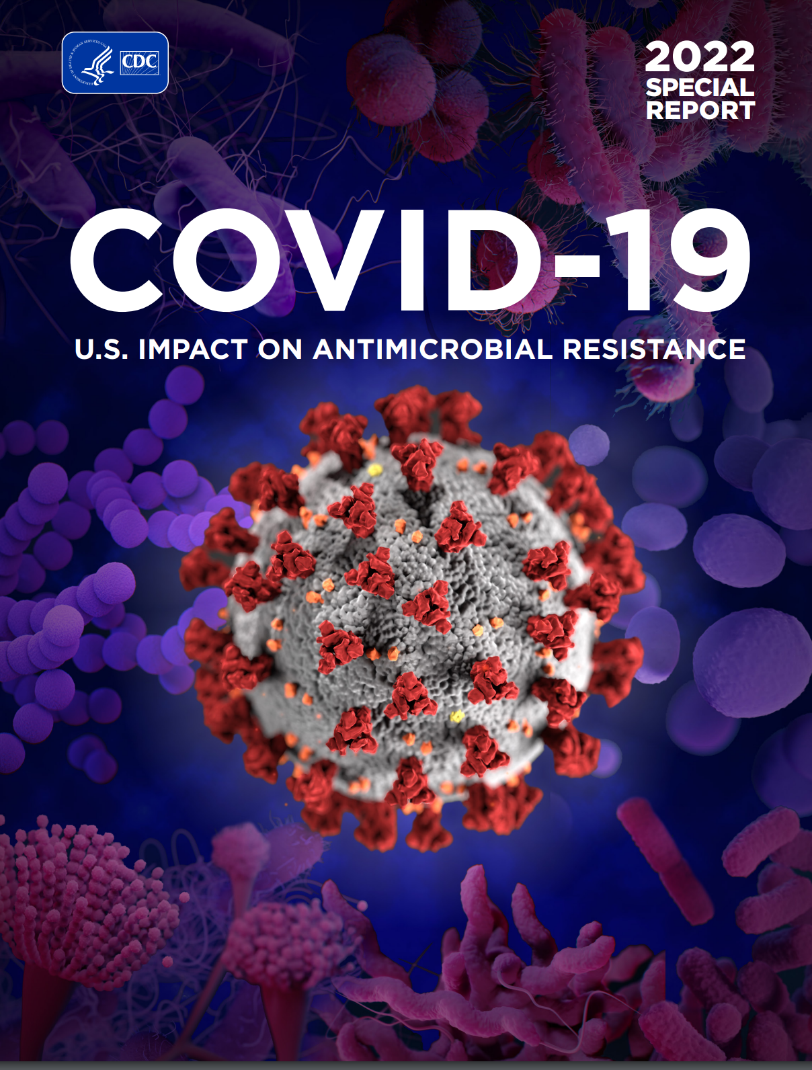
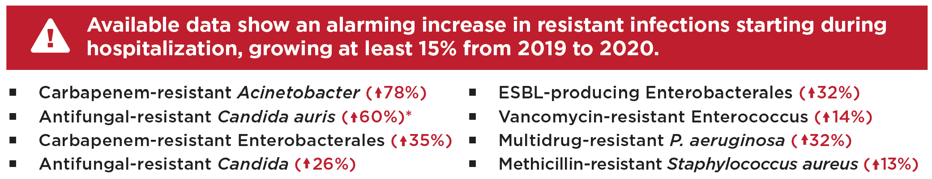
COVID-19 Reverses AMR Progress in the US
Major pandemic-related challenges:
Disruptions to standard infection prevention and control practices
Overuse of antibiotics - Nearly 80% of patients with COVID-19 received an antibiotic
Rerouting of resources used for active surveillance in hospitals

Slide 7


Slide 8
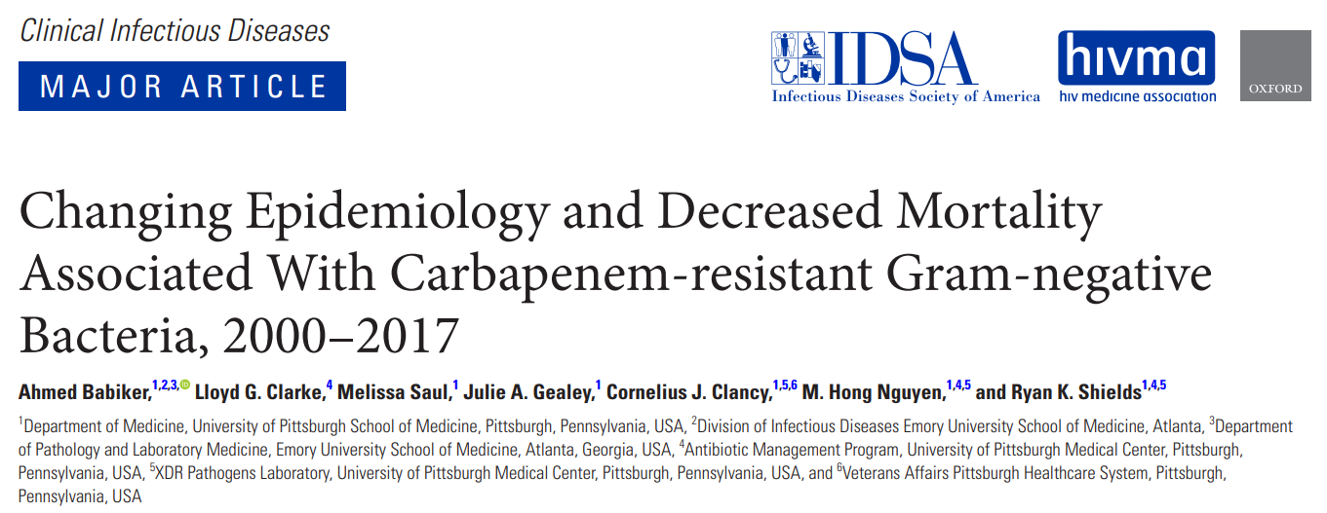

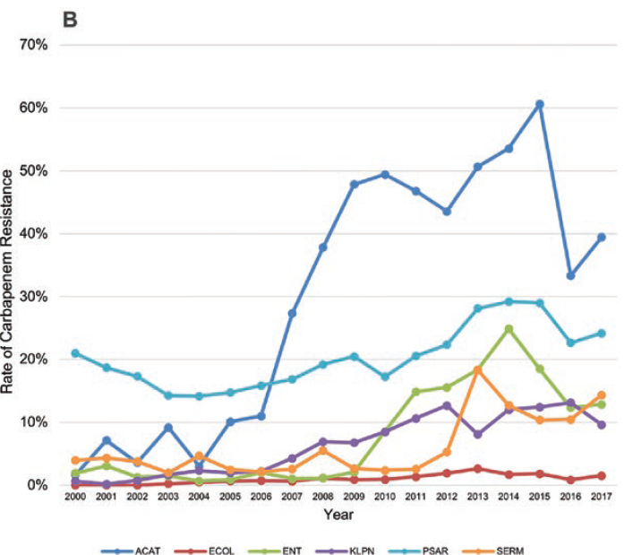
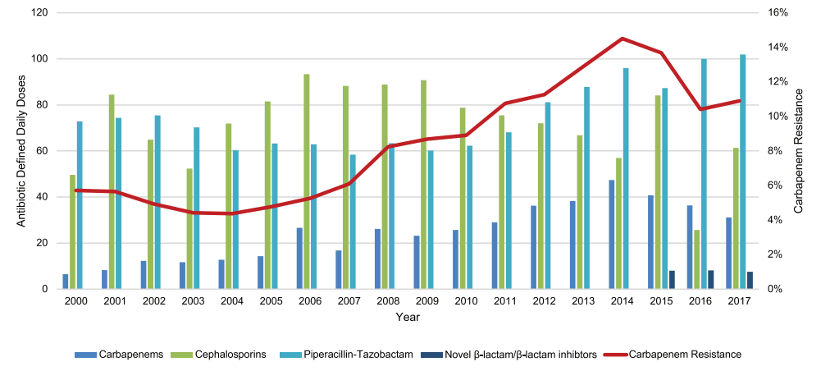
CR pathogens at UPMC
Analysis of the 6 most common Gram-negative pathogens from 2000 – 2017
9,882 isolates from 4,038 patients (P. aeruginosa accounted for 51%)
Rates of resistance are increasing and parallel of carbapenems at the hospital-level
Babiker A, et al. CID 2021

Slide 9
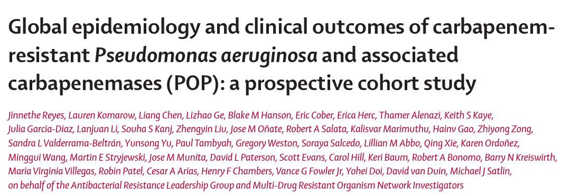
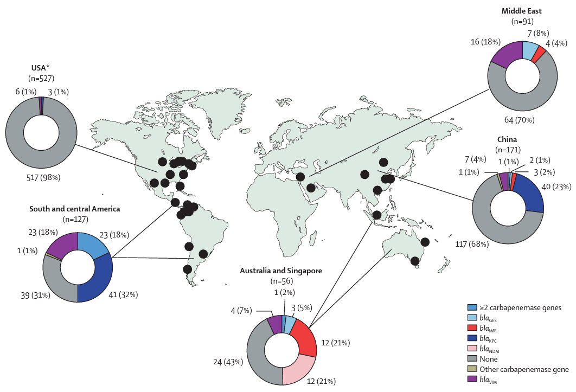
Carbapenemases in P. aeruginsoa
Clinical and molecular analysis of 972 cases of CRPa from 44 hospitals globally
60% with infection and 40% colonization
Key findings:
22% of isolates harbored CB’ase genes
2% in US to 69% in South and Central America
Meropenem MICs and cross-resistance to other β-lactams was higher in CB’ase producers
KPC-2 and VIM-1 were most common
Mortality rates higher among patients infected with CB’ase producing strains

Slide 10
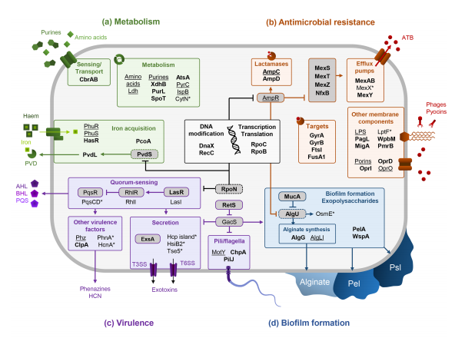
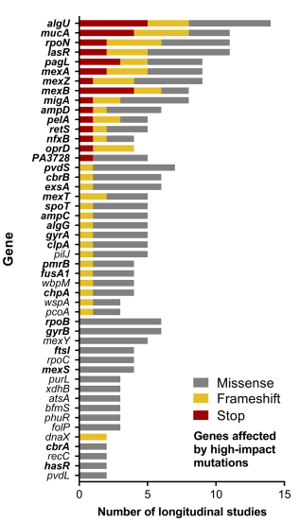
An organism prepared to evolve and evade
Versatility and adaptability conferred by a significant proportion (>8%) of regulatory genes encoded in its large genome (>6MB)
Camus L, et al. Microbial genomics 2021;7:000513
Notes:
High plasticity of the P. aeruginosa core and accessory genome allows the bacteria to prosper in diverse environments causing a range of acute invasive infections to chronic lung infections

Slide 11
Natural defenses against antibiotics
The outer membrane of P. aeruginosa is only 8% as permeable as E. coli which limits access of antibiotics to the periplasmic space
>160 known outer membrane proteins
Porins play an important role in the transport of sugars, cations, and β-lactams
Intrinsic β-lactamases that limit activity of many β-lactams
OXA-50
Inducible ampC (Pseudomonas-derived cephalosporinase [PDC])
Basal efflux limits utility of macrolides and tetracyclines
Constitutive expression of MexAB-OprM at baseline
Lister P, et al. Clin micro review 2009;22:582
Blair J, et al. Nature Rev Microbiol 2015;13:42-51
Babich T, et al. Clin Infect Dis 2020;;70(11):2270
Notes:
Water-filled protein channels called porins. Porins play an important role in the transport of sugars, amino acids, siderophores, cations, etc. Hydrophilic antibiotics like beta-lactams transverse through porin channels.
Genetic sequence of OprD is diverse across individual strains
Decreases susceptibility to meropenem by 4 to 32-fold and 4- to 16-fold for imipenem

Slide 12

Defining β-lactam resistance in P. aeruginosa
The first rule of β-lactam resistance in Pseudomonas is that there are no rules for β-lactam resistance in Pseudomonas.
In other words – its nearly impossible to draw definitive conclusions about phenotypes and genotypes…

Slide 13
β-lactam resistance in P. aeruginosa (traditional agents)
Mechanism | Gene(s) | Regulator(s) | TZP | CAZ | FEP | MEM | IMI
β-lactamases
AmpC overexpression | ampC | ampR, ampD, dacB, etc. | ✗ | ✗ | ± |  | ±
ESBL enzymes | bla_{PER, OXA, GES} | -- | ✗ | ✗ | ✗ |  | 
Serine carbapenemase | bla_{KPC, GES} | -- | ✗ | ✗ | ✗ | ✗ | ✗
Metallo carbapenemase | bla_{VIM, IMP} | -- | ✗ | ✗ | ✗ | ✗ | ✗
Membrane permeability
OprD loss/↓ expression | oprD | -- |  |  |  | ± | ±
Antibiotic efflux
MexAB-OprM ↑ expression | mexA, mexB | mexR, nalD, nalC | ± | ✗ | ✗ | ± | 
MexXY-OprM (MexCD-OprJ) | mexX, mexY | mexZ (nfxB) |  |  | ✗ |  | 
TZP = Piperacillin-tazobactam, CAZ = Ceftazidime, FEP = Cefepime, MEM = Meropenem, IMI = Imipenem
= Major impact on resistance
± = Some impact on resistance
 = Minor/No impact on resistance
Mechanisms often occur in concert with one another and expression levels can be variable!

Slide 14
β-lactam resistance in P. aeruginosa (new agents)
Mechanism | Gene(s) | Regulator(s) | CT | CZA | MVB | IPR | FID
β-lactamases
AmpC overexpression | ampC | ampR, ampD, dacB, etc. |  |  |  |  | 
ESBL enzymes | bla_{PER, OXA, GES} | -- | ± |  |  |  | 
Serine carbapenemase | bla_{KPC, GES} | -- | ✗ |  |  |  | 
Metallo carbapenemase | bla_{VIM, IMP} | -- | ✗ | ✗ | ✗ | ✗ | 
Membrane permeability
OprD loss/↓ expression | oprD | -- |  |  | ± | ± | 
Antibiotic efflux
MexAB-OprM ↑ expression | mexA, mexB | mexR, nalD, nalC |  | ± | ± | ± | 
MexXY-OprM (MexCD-OprJ) | mexX, mexY | mexZ (nfxB) |  |  |  |  | 
CT = Ceftolozane-tazobactam, CZA = Ceftazidime-avibactam, MVB = Meropenem-vaborbactam, IMP = Imipenem-relebactam, FID = Cefiderocol
= Major impact on resistance
± = Some impact on resistance
 = Minor/No impact on resistance
Mechanisms often occur in concert with one another and expression levels can be variable!
Notes:
Because of the overlapping activity against multiple mechanisms – it becomes difficult to know where to pick one agent over another – this has been particularly true to C/T and CZA

Slide 15
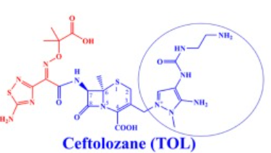
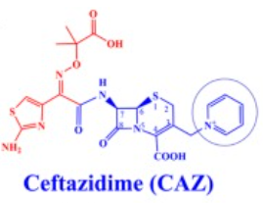
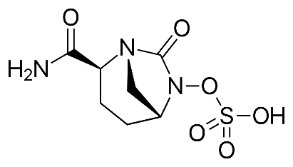
Ceftolozane-tazobactam vs Ceftazidime-avibactam
+
Avibactam
Ceftolozane-tazobactam
R2 side chain substitutions leads to:
↑ stability against AmpC
↑ affinity for PBPs
↓ efflux
Tazobactam does not help against acquired β-lactamases in P. aeruginosa
Ceftazidime-avibactam
Addition of avibactam leads to:
↑ stability against AmpC, ESBLs, and KPC
MDR P. aeruginosa (MIC50/90)
CAZ = 32/>32
CAZ-AVI = 8/32
Barnes MD, et al. mBio 2018;9:e02085-18; Sader HS, et al. AAC 2017;61:e01045-17

Slide 16
Ceftolozane-tazobactam vs Ceftazidime-avibactam
 | Ceftolozane/tazobactam |  | Ceftazidime/avibactam
 | % Susceptible | MIC50/90 | % Susceptible | MIC50/90
Buerhrle (n=38) | 92 | 1/4 | 92 | 1/8
Gonzalez (n=45) | 87 | 1/8 | 82 | 2/16
Grupper (n=290) | 91 | 1/4 | 81 | 1/8
Humphries (n=309) | 73 | NR | 62 | NR
Sader (n=526) | 84 | 2/16 | 84 | 4/16
Patel (n=101) | 81 | 2/8 | 87 | 4/16
Rates vary according to local epidemiology and definitions of resistance
Buehrle D et al. Antimicrob Agents Chemother 2016;60:3227-31
Gonzales MD et al. Ann Lab Med 2017;37:174-176
Grupper M et al. Antimicrob Agents Chemother 2017;61:e00875
Humphries RM et al. Antimicrob Agents Chemother 2017;61:e01858
Sader HS et al. Diag Micro Infect Dis 2020;96:114833
Patel TS et al. IDWeek 2019 (Poster 512)

Slide 17
What drives basal differences in % susceptibility?
Mechanism | N | CAZ | CAZ-AVI | TOL-TAZ
AmpC derepressed | 149 | 20.8 | 94.6 | 96.6
Efflux normal | 303 | 100 | 100 | 100
Efflux high | 398 | 65.3 | 86.0 | 99.7
Efflux very high | 152 | 27.4 | 41.7 | 94.7
ESBL + GES | 50 | 28 | 38 | 34
Clinical question: If both agents are susceptible, is there a difference in clinical efficacy? (To be addressed later…)
Livermore DM, et al. JAC 2017
Livermore DM, et al. JAC 2018

Slide 18
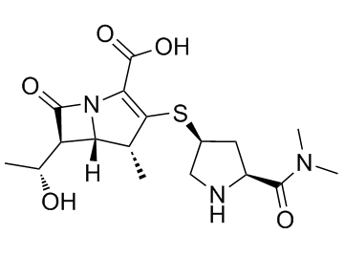
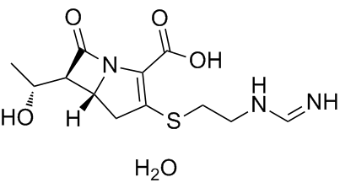
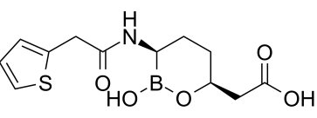
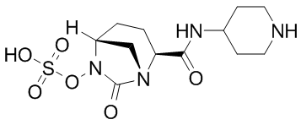
Meropenem-vaborbactam .vs Imipenem-relebactam
Meropenem
Resistance is due to:
↓ OprD + ↑MexAB-OprM
Imipenem
Resistance is due to:
↑ AmpC + ↓ OprD
Vaborbactam
Boronic acid β-lactamase inhibitor
Broad inhibitor of class A and C
Potent against KPC, ESBL, and AmpC
Relebactam
DBO β-lactamase inhibitor
Broad inhibitor of class A and C
Potent against KPC, ESBL and AmpC
Drug | MIC50 | MIC90
Meropenem | 8 | 32
MER-VAB | 8 | 32
Drug | MIC50 | MIC90
Imipenem | 8 | >16
IMI-REL | 1 | 2
Against Mero-R P. aeruginosa (n=98)
These data do not include KPC-producing P. aeruginosa
Against Imipenem-R P. aeruginosa (n=114)
Lapuebla et al. AAC 2015;59:4856

Slide 19
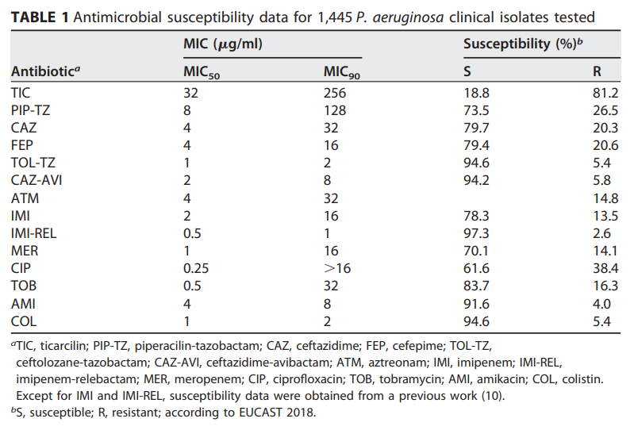
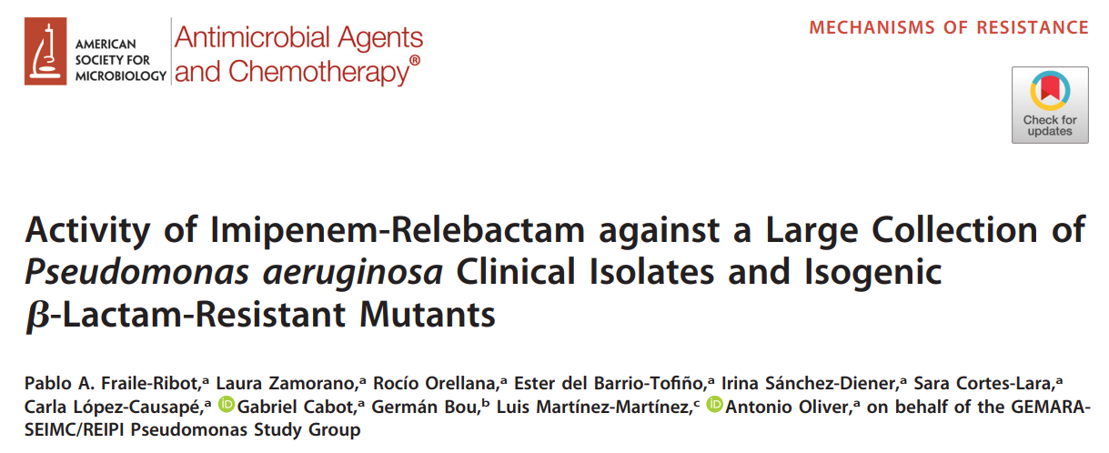
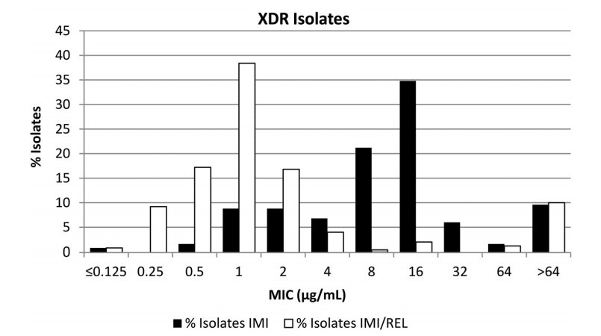
Imipenem-relebactam against XDR P. aeruginosa
All agents show very high rates of susceptibility in surveillance studies
Fraile-Ribot P A, AAC 2020;64:e02165-19

Slide 20
How do they all compare against resistant isolates?
Against pan-β-lactam resistant P. aeruginosa
SMART surveillance (US)
University of Michigan
Rates are likely to vary by center and local epidemiology!
Hilbert DW, et al. World Microbe Forum 2021
Klatt M, et al. ECCMID 2021

Slide 21
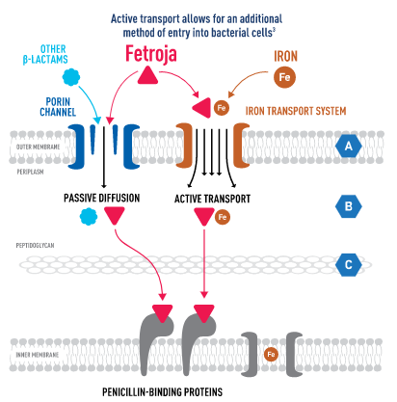
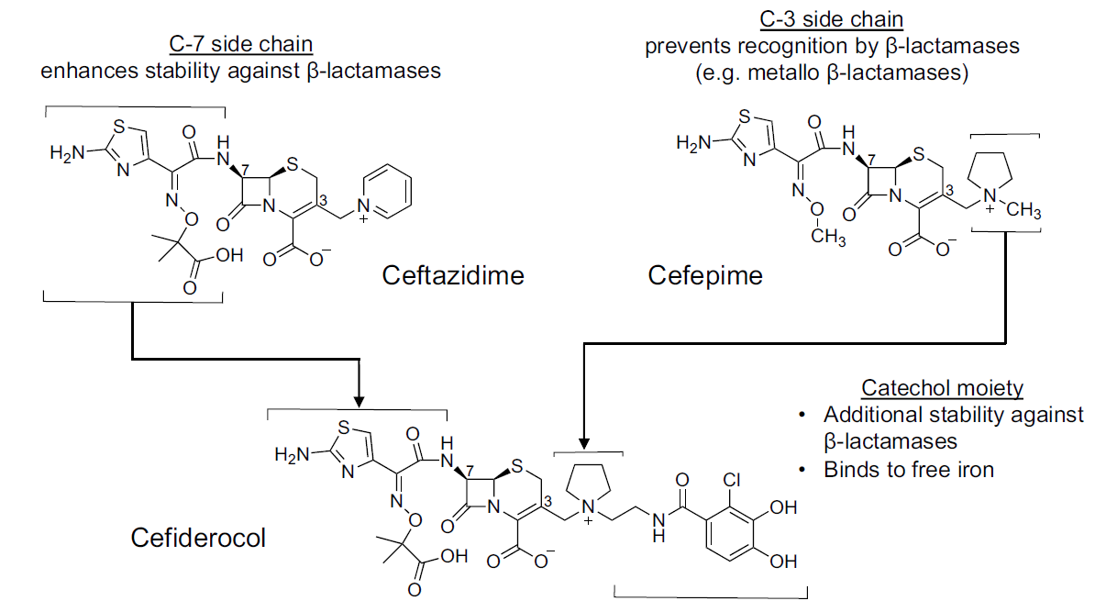

Cefiderocol – The Frankenstein β-lactam
Cefiderocol
Zhanel G, et al. Drugs 2019;79:271

Slide 22
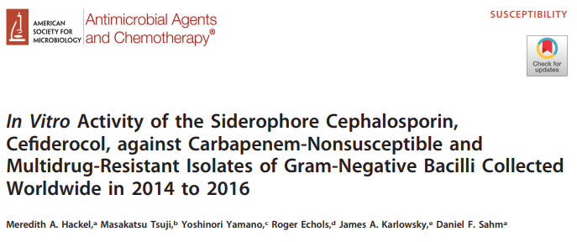
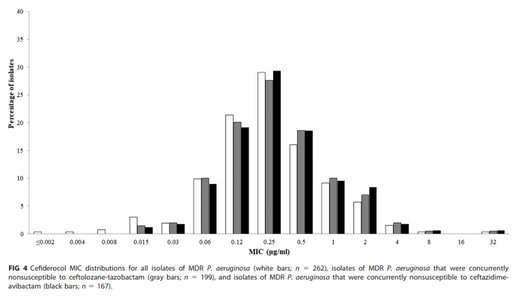
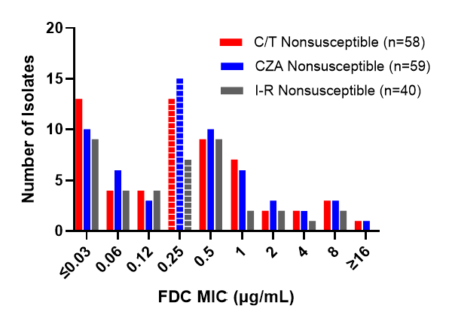
Cefiderocol against MDR and XDR P. aeruginosa
Cefiderocol does not lose activity against isolates non-susceptible to C/T and CZA at baseline (including MBL-producing P. aeruginosa)
Against 178 P. aeruginosa clinical isolates tested at UPMC, including serial isolates from treated patients
Hackel MA et al. AAC 2018;62:e01968-17
Shields RK, et al. ASM Microbe 2020

Slide 23
Presentation outline
Brief review of how P. aeruginosa evade killing by β-lactam antibiotics
How well do the newest β-lactams expand our armamentarium?
Emerging phenotypes with interesting genotypes clinicians need to know
Cross-resistance and collateral susceptibility mechanisms that impact patient care
Looking forward – what is the preferred agent for MDR P. aeruginosa?
Do we need to be more aggressive in using newer β-lactams?
Is one new agent better than another?

Slide 24
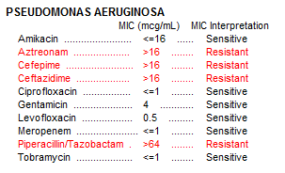
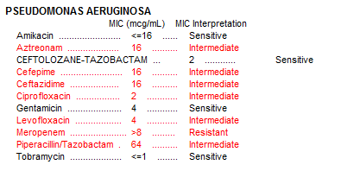
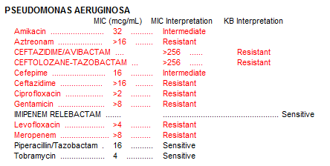
Selection of β-lactam resistance in P. aeruginosa
55 y/o female with NICM s/p LVAD with recurrent driveline infections and bacteremia due to MDR P. aeruginosa following exposures to β-lactams
?
Lots of prior exposures
Meropenem x 8 days
TOL-TAZ x 2 weeks
Clinical questions:
What is the mechanism of TOL-TAZ resistance?
Why is this CAZ-AVI resistant despite never being exposed?
Is this a new strain given that pip/tazo is susceptible?
Are other new agents an option for treatment?

Slide 25
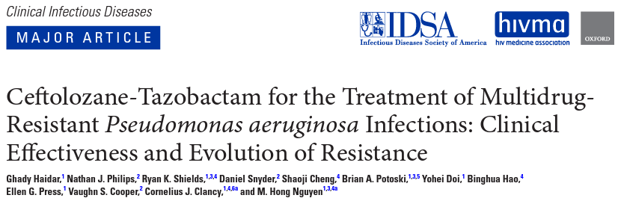

Ceftolozane-tazobactam resistance
Rates of treatment-emergent resistance vary
14% (8/58) in Spain (Diaz-Canestro, et al. 2018, Fraile-Ribot, et al. 2018)
14% (3/21) in Pittsburgh_{(Haidar, et al. 2017)}
3% (3/101) in Italy _{(Bassetti, et al. 2019)}
50% (14/28) in Baltimore_{(Tamma, et al. 2021)}
Dosing, patient populations, infection types and duration of follow-up are not standardized in observational studies
Among 93 patients at UPMC with bacteremia or pneumonia due to MDR P. aeruginosa who were followed for up to 90 days:
10% (9/93) had microbiologic failures associated with ≥4-fold MIC increase to C/T
11% (10/93) developed C/T resistance (defined by an MIC >8 mg/L in triplicated by BMD)
Fraile-Ribot P, et al. JAC 2018;73:658-663; Haidar G, et al. CID 2017;65:110-120; Bassetti M, et al. Int J Antimicrob Agents 2019;53:408-415 Tamma P, et al Clin Infect Dis 2021 73(11):e4599;Diaz-Canestro M, et al. Eur J Clin Micro Infect Dis 2018;37:2191

Slide 26
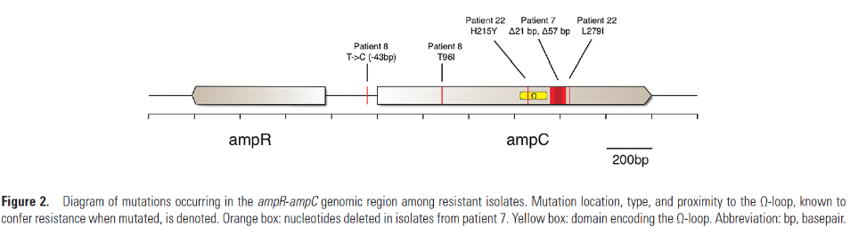
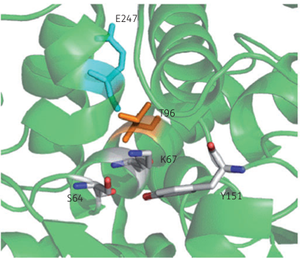
Mechanisms of Ceftolozane-tazobactam resistance
Resistance is primarily mediated by mutations in Pseudomonas-derived cephalosporinase (PDC)
Mutations include those within Ω-loop and residues that interact with it
Strain | PDC | C/T MIC (mg/L)
PAO1 | Wild-type | ≤0.5
PAO1 | pUCPAmpC_{G183K} | 16
PAO1 | pUCPAmpC_{F147L} | 16
PAO1 | pUCPAmpC_{T96I} | 32
PAO1 | pUCPAmpC_{delG229-E247} | 32
PAO1 | pUCPAmpC_{E247K} | 32
Fraile-Ribot P, et al. JAC 2018;73:658-663; Fraile-Ribot P, et al. AAC 2020;64(2):e02165-19
Notes:
E247 is in omega loop, predicted by in vitro selection; T96 directly interacts with E247, resulting in an extended-spectrum cephalosporinase.
E221K variant in the omega loop creates a hidden pocket adjacent to the catalytic site that opens and stabilizes ceftolozane for efficient hydrolysis
E= glutamic acid; K = Lysine
Pay attention to the threonine at postion 96 is in the H2 helix which interacts with a serine in the active site through a hydrogen bond….
The T96I substitution in resistant isolates from patient 8 occurred within the H2 helix, which lies close to the serine active site and interacts with the Ω-loop through hydrogen binding [59]. H2 helix mutations can render the active-site serine more pliable, opening the Ω-loop entrance to accommodate larger cephalosporins such as ceftolozane
which is not within the omega loop, but

Slide 27
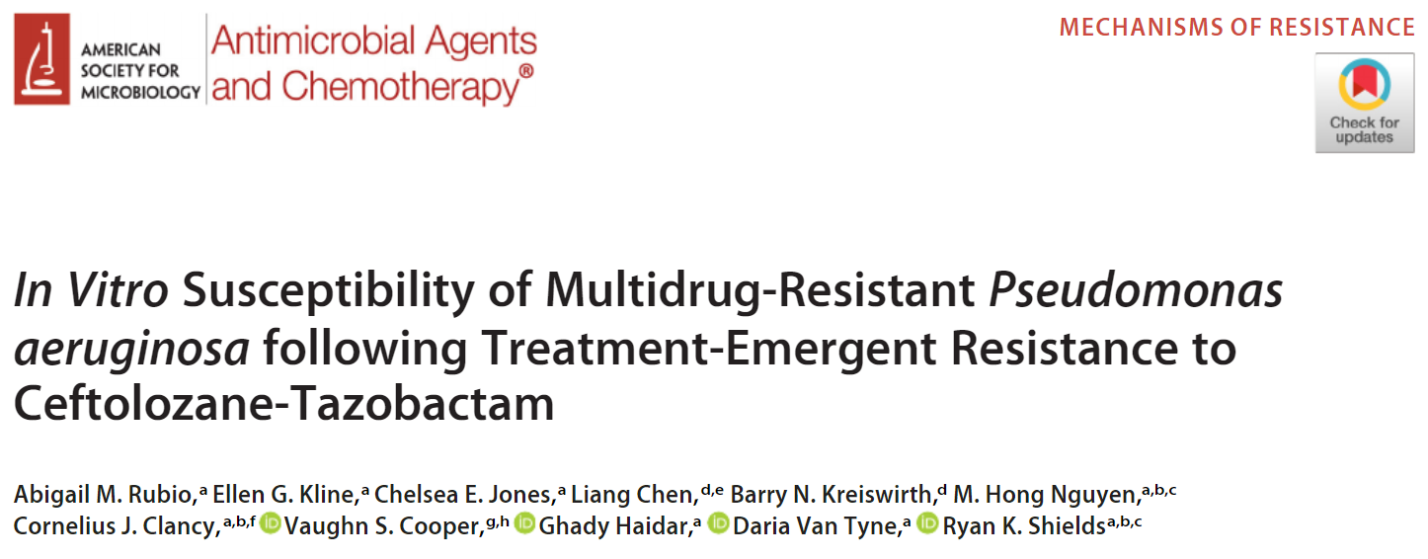

Collateral effects of C/T resistance
Paired isolates were tested from 23 patients who developed C/T resistant P. aeruginosa
Median = 20 days of exposure (range: 4 – 53)
Minimum inhibitory concentrations (mg/L)
Isolate | DOT | SNPs | AmpC | dacB | ftsI | C/T | CAZ | CZA | TZP | IMI | IPR
1 | 0 | -- | PDC-5 | WT | WT | 1 | 8 | 1 | 128 | 16 | 2
2 | 26 | 2 | P243S | WT | WT | 16 | 32 | 4 | 16 | 2 | 1
3 | 45 | 291 | G183D, 243Gins | S257L | M460T | 128 | 128 | 128 | 32 | 1 | 1
Resistance was primarily due to AmpC mutations
Mutations in ampR, ampD, and dacB played a complimentary role
PBP3 (ftsI) mutations (R504C) were identified in 21% of isolate pairs
Cross-resistance to ceftazidime-avibactam was common
C/T = Ceftolozane/tazobactam; CAZ = Ceftazidime; CZA = Ceftazidime-avibactam; TZP = Piperacillin/tazobactam; IMI = Imipenem; IPR = Imipenem-relebactam
Rubio AM, et al. AAC 2021;65:e0084-21

Slide 28
Collateral effects of C/T resistance
Paired isolates were tested from 23 patients who developed C/T resistant P. aeruginosa
Median = 20 days of exposure (range: 4 – 53)
Comparing median MICs against baseline and post-treatment isolates w/ AmpC mutations:
C/T MICs increased by 64-fold
CZA MICs increased by 16-fold
Imipenem MICs decreased by 8-fold
Pip/tazo MICs decreased by 4-fold
Imipenem-relebactam MICs decreased by 2-fold
79% of C/T resistant isolates were susceptible to imipenem-relebactam
Rubio AM, et al. AAC 2021;65:e0084-21
Notes:
6a-hydroxyethyl side chain away from key binding residues thereby evading hydrolysis

Slide 29
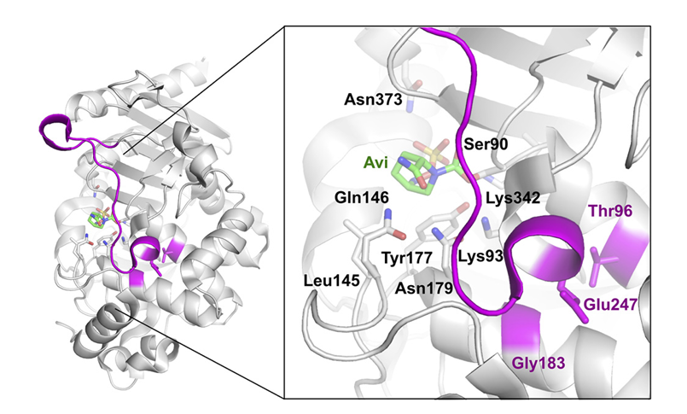
PDC mutations lead to cross-resistance to ceftazidime-avibactam
Enzyme-kinetic studies show an increased catalytic efficiency
Mean K_{cat}/K_{m} fold-change
PDC variant | Ceftolozane | Ceftazidime
Wild-type | 1 | 1
T96I | 40.5 | 16.6
G183D | 31.2 | 10.3
E247K | 83.7 | 47.2
ΔG229-E247 | 24.8 | 10.1
PDC mutations also reduce the affinity for avibactam!
Based on impact on C/T MICs and kinetics:
WT<G183D <delG229-E247 = T96I <E247K
Slater CL, et al. AAC 2020;64(9):e00894-20

Slide 30
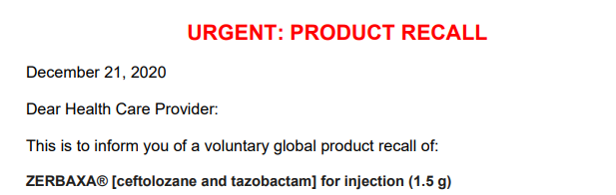

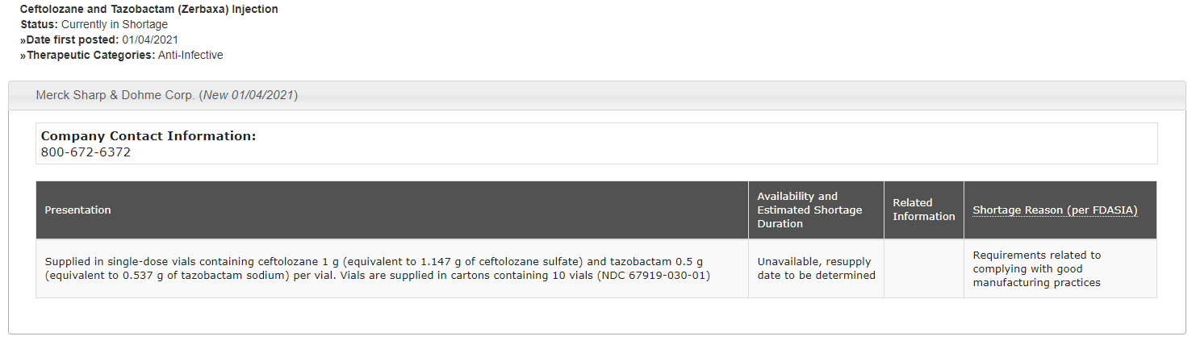
And then 2020 went from bad to worse…..

Slide 31

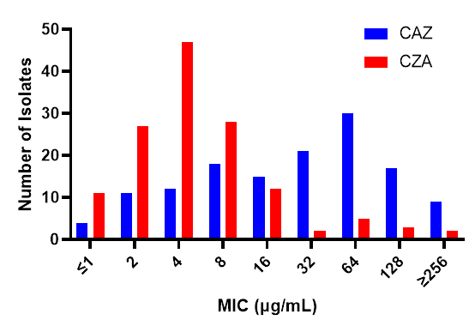
Option 1: Ceftazidime-avibactam
Prioritized for MDR P. aeruginosa after C/T shortage
Not always better than ceftazidime alone = must check the MICs
S
R

Slide 32
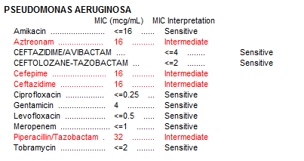
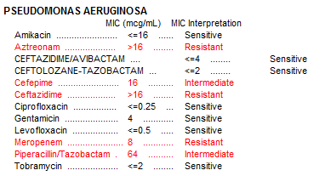
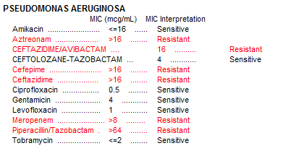
Option 1: Ceftazidime-avibactam
In our early experience rates of emergent resistance were very high!
64 y/o male w/ S. mitis endocarditis s/p MVR. Post-op c/w MDR P. aeruginosa VAP
Mero x 11 days
CZA x 12 days

Slide 33
Ceftazidime-avibactam resistance
In our early experience rates of emergent resistance were very high!
64 y/o male w/ S. mitis endocarditis s/p MVR. Post-op c/w MDR P. aeruginosa VAP
Isolate | DOT | SNPs | AmpC* | ampD | mexR | MexAB-OprM | OprD | CZA | CT
1 | 0 | -- | PDC-8 | WT | WT | WT | Disrupted | 2 | 2
2 | 9 | 4 | PDC-8 | R24S | Y3* | WT | Disrupted | 16 | 8
3 | 12 | 4 | PDC-8 | R24S | Y3* | WT | Disrupted | 16 | 8
↑↑↑ AmpC expression + ↑↑↑ efflux = consistent finding across CZA-R isolates sequenced thus far

Slide 34
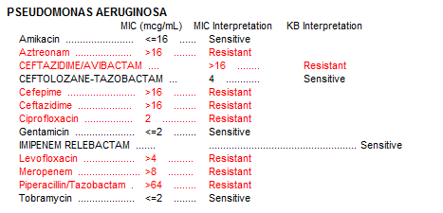
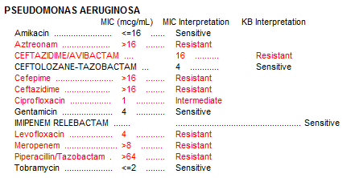

Option 2: Imipenem-relebactam
Imipenem-relebactam use in MDR P. aeruginosa
55 year old man with newly diagnosed HIV
Chronic respiratory failure and prolonged hospitalization
Imi-rel x 14 days
Imi-rel x 14 days
Sidenote: Etests for imipenem-relebactam overcall resistance (recalled by FDA); unclear if disks are significantly better

Slide 35
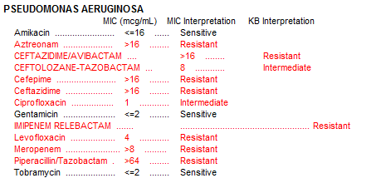
Yeah, you guessed it
55 year old man with newly diagnosed HIV infection
Chronic respiratory failure and prolonged hospitalization
Clinical questions:
What is the mechanism of imipenem-relebactam resistance?
Does cross-resistance or collateral sensitivity occur as a result?
What are the remaining therapeutic options?

Slide 36
So what happened?
55 year old man with newly diagnosed HIV infection
Chronic respiratory failure and prolonged hospitalization
Minimum inhibitory concentrations (mg/L)
Isolate | DOT | SNPs | AmpC* | mexB | MexEF-OprN | mexT | OprD | IPR | IMI | C/T | CZA
1 | 0 | -- | PDC-19 | WT | WT | WT | Disrupted | 1 | 32 | 4 | >16
2 | 14 | 4 | PDC-19 | WT | WT | A249fs | Disrupted | 2 | 32 | 4 | >16
3 | 20 | 10 | PDC-19 | K134N | H502fs (mexF) | S250fs | Disrupted | 8 | 32 | 8 | >16
4 | 28 | 11 | PDC-19 | K143N | H502fs (mexF) | G148R, S250fs | Disrupted | 16 | 32 | 4 | >16
*No change in AmpC regulator genes
C/T = Ceftolozane/tazobactam; CZA = Ceftazidime-avibactam; IMI = Imipenem; IPR = Imipenem-relebactam
Shields RK, et al. CID 2022
Notes:
mexT is a repressor

Slide 37
So what happened?
55 year old man with newly diagnosed HIV infection
Chronic respiratory failure and prolonged hospitalization
Minimum inhibitory concentrations (mg/L)
Isolate | DOT | SNPs | AmpC* | mexB | MexEF-OprN | mexT | OprD | IPR | IPR + PAβN | IMI | IMI + PAβN
1 | 0 | -- | PDC-19 | WT | WT | WT | Disrupted | 1 | 0.5 | 32 | 8
2 | 14 | 4 | PDC-19 | WT | WT | A249fs | Disrupted | 2 | 0.5 | 32 | 16
3 | 20 | 10 | PDC-19 | K134N | H502fs (mexF) | S250fs | Disrupted | 8 | 1 | 32 | 16
4 | 28 | 11 | PDC-19 | K143N | H502fs (mexF) | G148R, S250fs | Disrupted | 16 | 2 | 32 | 16
*No change in AmpC regulator genes
PAβN is a broad efflux inhibitor
Patient was treated successfully with cefiderocol for 14 days (MIC = 1 mg/L)
C/T = Ceftolozane/tazobactam; CZA = Ceftazidime-avibactam; IMI = Imipenem; IPR = Imipenem-relebactam
Shields RK, et al. CID 2022

Slide 38
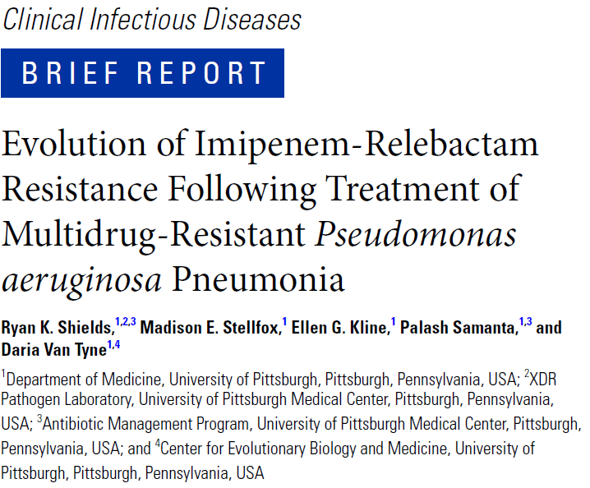


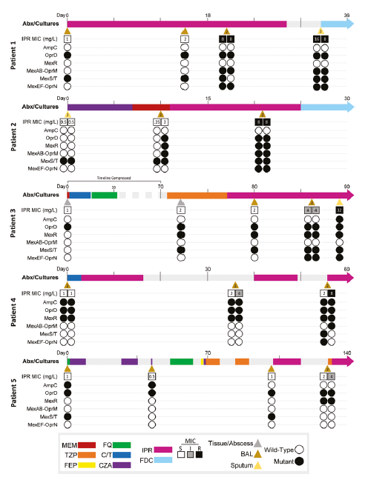
Evolution of imi-rel resistance at UPMC
26% (5/19) of patients treated with imipenem-relebactam for MDR P. aeruginosa infections
Median pre-tx MIC: 0.5 – 1 mg/L
Median post-tx MIC: 4 – 32 mg/L
Exposures ranged from 10 – 28 days before the emergence of resistance
Independent evolution of mutations in MexAB-OprM and/or MexEF-OprN efflux operons in 5 patients infected with diverse P. aeruginosa
Imipenem-relebactam susceptibility was restored through efflux inhibition
Likely due to the preferential efflux of relebactam
Cefiderocol retained in vitro activity against 100% of isolates in the study
Shields RK, Stellfox ME, Kline EG, Samanta P, Van Tyne D. CID 2022
Notes:
Two patients developed sequential resistance to CT and IPR

Slide 39
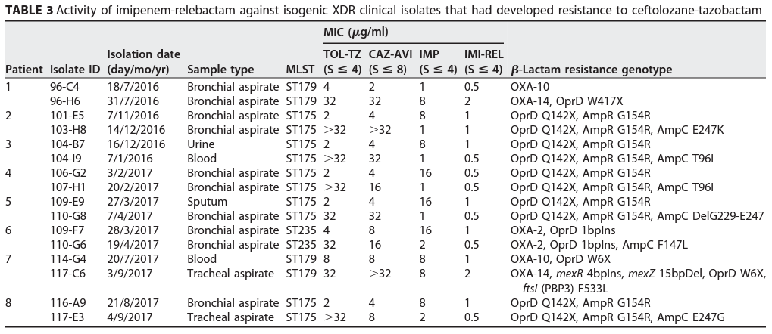
Collateral effects of C/T resistance
Our findings were consistent with paired isolates from 8 patients in Spain
CT ➔ CZA cross resistance in 88% of patients; 100% of isolates were susceptible to imipenem-relebactam
Fraile-Ribot P, et al. AAC 2020;64(2):e02165-19

Slide 40
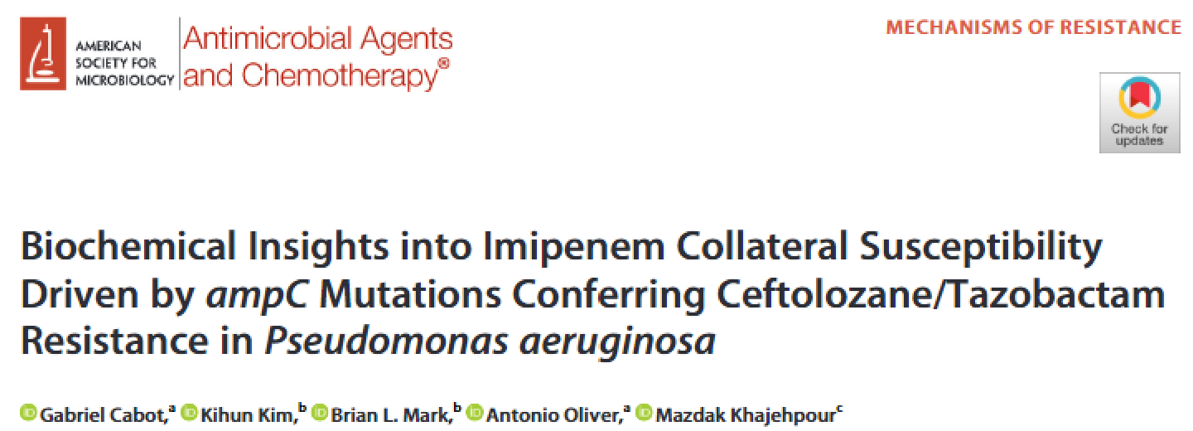
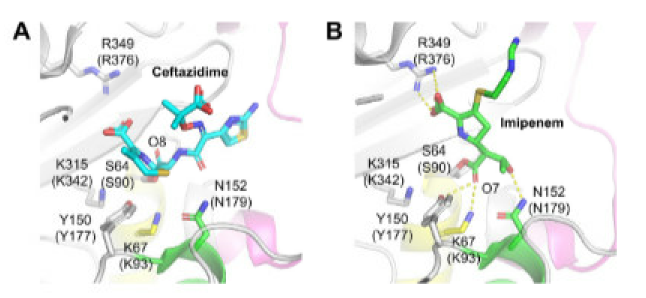
Collateral susceptibility to imipenem
Mean ± SD K_{cat}/K_{m} fold-change
PDC variant | Ceftolozane | Ceftazidime | Imipenem
Wild-type | 1 | 1 | 1
T96I | 40 ± 2 | 17 ± 3 | 0.016 ± 0.08
G183D | 31 ± 5 | 10.3 ± 0.1 | 0.11 ± 0.03
E247K | 80 ± 20 | 47 ± 5 | 0.16 ± 0.03
ΔG229-E247 | 25 ± 1 | 10.1 ± 0.1 | 0.09 ± 0.01
Cabot G, et al. AAC 2023;67(2):e01409-22

Slide 41
Option 3: Cefiderocol
Potential option for treatment of highly evolved P. aeruginosa
Appears to have preserved susceptibility in the face of resistance to other novel agents
Study of 178 MDR P. aeruginosa clinical isolates
100 MDR isolates selected at random from unique patients at UPMC
36 serial isolates from 14 patients who developed CT resistance
13 serial isolates from 4 patients who developed CZA resistance
29 serial isolates from 5 patients who developed resistance to IPR
80% also developed resistance to CT and CZA

Slide 42
Option 3: Cefiderocol
6% (11/178) of MDR P. aeruginosa isolates demonstrated FDC MICs ≥2 mg/L
Mutations were identified in ampC, ampD, ampR, ftsI, and/or oprD
55% (6/11) harbored mutations in pirR or piuD
No common mutations were identified in other ton-B dependent receptors
All isolates with FDC MICs >4mg/L were also resistant to CT and harbored mutations in ampC

Slide 43
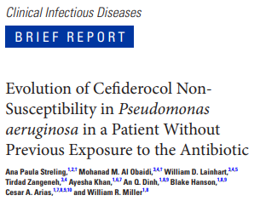
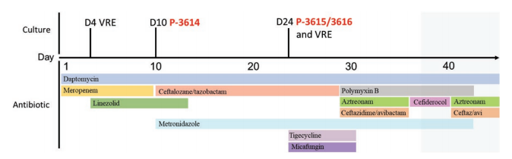
Option 3: Cefiderocol for MDR Pseudomonas
30 y/o woman with MDR P. aeruginosa BSI and IAI
Develops C/T resistance after 14 days
Due to F147L mutation in ampC
Corresponding FDC MICs increased from 2 ➔ 8 mg/L
Mutations in piuD and pirR
Streling AP, et al. CID 2020
Notes:
TonB dependent receptors – associated with iron acquisition

Slide 44

Whoa! Is this really possible?
Short answer: Yes
FDC = Cefiderocol
Isolate | DOT | SNPs | AmpC | dacB | ftsI | pirR | pirA | C/T | CZA | IMI | IPR | FDC
1 | 0 | -- | PDC-5 | WT | WT | WT | WT | 1 | 1 | 16 | 2 | 0.25
2 | 26 | 2 | P243S | WT | WT | WT | WT | 16 | 4 | 2 | 1 | 1
3 | 45 | 291 | G183D, 243Gins | S257L | M460T | 1 bp ins (FS) | L642P | 128 | 128 | 1 | 1 | 16
14% (3/21) of patients that evolved ceftolozane-tazobactam resistance showed cross resistance to cefiderocol
Median cefiderocol MICs were increased by 4-fold following exposure to ceftolozane-tazobactam
↑ ampC
PBP3
TBDR
Streling AP, et al. CID 2020
Simner PJ, et al. OFID 2021
TBDR = tonB-dependent receptor

Slide 45
Presentation outline
Brief review of how P. aeruginosa evade killing by β-lactam antibiotics
How well do the newest β-lactams expand our armamentarium?
Emerging phenotypes with interesting genotypes clinicians need to know
Cross-resistance and collateral susceptibility mechanisms that impact patient care
Looking forward – what is the preferred agent for MDR P. aeruginosa?
Is one new agent better than another?
Do we need to be more aggressive in using newer β-lactams?

Slide 46
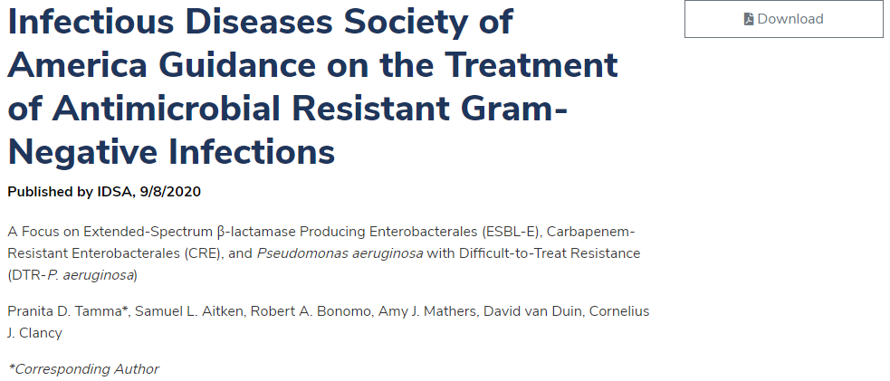
IDSA Guidance
General recommendations:
For difficult-to-treat (DTR) P. aeruginosa infections consider the following
Ceftolozane-tazobactam, ceftazidime-avibactam, and imipenem-relebactam, as monotherapy are preferred options
Cefiderocol as monotherapy is an alternative agent
Combination therapy not recommended
Nebulized antibiotics not recommended
Risk of treatment-emergent resistance may be higher for ceftolozane-tazobactam and ceftazidime-avibactam compared to others
Available at: https://www.idsociety.org/practice-guideline/amr-guidance/

Slide 47

ESCMID Guidelines
General recommendations:
For carbapenem-resistant P. aeruginosa infections consider the following
Ceftolozane-tazobactam is the preferred option
Insufficient evidence to recommend ceftazidime-avibactam, imipenem-relebactam, and cefiderocol at this time
Combination therapy not recommended for new BL-BLI agents
Combination therapy is recommended if using polymyxins, aminoglycosides, or fosfomycin
Paul M, et al. Clin Micro Infect 2022;28:521-547

Slide 48


Ceftolozane-tazobactam real-world evidence
Retrospective, multicenter cohort study
6 centers in the US
Receipt of C/T or Poly/AG for at least 48 hours as definitive therapy
Mixed infection types; mostly pneumonia
100 patients in each arm
NNT with C/T for one additional cure = 5
NNH with Poly/AG for one case of AKI = 4
P<0.001

Slide 49


Ceftolozane-tazobactam real-world evidence
Retrospective, multicenter cohort study
5 centers in Saudi Arabia
Receipt of C/T or colistin for at least 48 hours as definitive therapy
N=82 for C/T and N=100 for colistin
In multivariable analysis, treatment with C/T was independently associated with clinical cure (OR=2.47, 95% CI:1.16-5.27)
P<0.001

Slide 50
Remaining Knowledge Gaps
Among the 4 β-lactam agents with expanded in vitro activity for MDR P. aeruginosa
We know that C/T is better than colistin (polymyxin B)
There are very limited data for the other options (RWE limited to case-series and observations)
There are NO comparative-effectiveness data for any of these agents

Slide 51

A multicenter, observational study to compare the effectiveness of Ceftazidime-Avibactam versus Ceftolozane-Tazobactam for multidrug-resistant Pseudomonas aeruginosa infections in the United States (CACTUS)
Objective: To compare the clinical efficacy of C/T vs. CZA for the treatment of MDR P. aeruginosa pneumonia and bloodstream infections.
Study design: Retrospective, matched cohort study
Patients matched by study site, severity of illness, infection site, and time to initiation of treatment
Sample size: 420 patients (210 matched pairs)
Available isolates will be shipped to U. of Pittsburgh for molecular characterization and susceptibility testing
29 U.S. based sites – all major academic medical centers where MDR P. aeruginosa is prevalent

Slide 52
CACTUS progress to date
Preliminary data submitted to IDWeek 2023
Key outcomes include:
Composite clinical outcome at 30 days
All-cause mortality
Rates of treatment-emergent resistance
Time to clinical response: Return to baseline oxygenation, resolution of leukocytosis, defervescence, etc.
234 matched cases included to date (goal = 420)
Cases included from 20 centers so far

Slide 53
CACTUS: Patient demographics
 | CT (n=117) | CZA (n=117) | P-value
Median age in years (range) | 61 (19 – 89) | 60 (19 – 87) | 0.379
Male sex, n (%) | 70 (59.8) | 72 (61.5) | 0.894
Race Caucasian African American Other | 65 (55.6) 30 (25.6) 22 (18.8) | 66 (56.4) 37 (31.6) 14 (12.0) | 0.284
Solid-organ transplant recipient, n (%) | 19 (16.2) | 17 (14.5) | 0.857
Other immunocompromising condition, n (%) | 16 (13.7) | 12 (10.3) | 0.546
Median Charlson Comorbidity Index (range) | 5 (0 – 16) | 4 (0 – 15) | 0.071
Origin of hospital admission, n (%) Home LTAC/SNF Outside hospital | 60 (51.3) 26 (22.2) 31 (26.5) | 59 (50.4) 36 (30.8) 22 (18.8) | 0.207
Immunocompromising conditions (not including SOT):
CT = Neutropenia (n=10), Steroids (n=4), BMT (n=2)
CZA = Neutropenia (n=4, AIDS (n=2), Steroids (n=6)

Slide 54
CACTUS: Severity of illness
 | CT | CZA | P-value
Median SOFA score (range) | 7 (0 – 19) | 7 (0 – 17) | 0.574
Median Pitt Bacteremia score (range) | 4 (0 – 11) | 4 (0 – 12) | 0.869
Baseline renal replacement therapy, n (%) | 34 (29.1) | 28 (23.9) | 0.459
ICU at treatment initiation, n (%) | 93 (79.5) | 87 (74.4) | 0.438
Severe sepsis/septic shock, n (%) | 69 (59.0) | 68 (58.1) | 1.000
Vasopressors at study drug initiation, n (%) | 46 (39.3) | 41 (35.0) | 0.589
Mechanical ventilation, n (%) | 83 (70.9) | 74 (63.2) | 0.266

Slide 55
CACTUS: Treatment characteristics
 | CT | CZA | P-value
Bacteremia, n (%) | 24 (20.5) | 24 (20.5) | 1.000
Pneumonia, n (%) CAP HAP VAP vHAP | 93 (79.5) 13 (14.0) 11 (11.8) 51 (54.8) 18 (19.4) | 93 (79.5) 18 (19.4) 11 (11.8) 54 (58.1) 10 (10.8) | 0.365
Median time to study drug in hours (range) | 72 (-26 – 159) | 72 (-47 – 163) | 0.532
Active treatment before study drug, n (%) | 26 (22.2) | 21 (17.9) | 0.514
Time to active treatment initiation in hours (range) | 66 (-26 – 159) | 67 (-47 – 163) | 0.858
Receipt of prolonged infusion, n (%) | 42 (35.9) | 22 (18.8) | 0.005
Median treatment duration, n (%) | 9 (2 – 35) | 8 (2 – 34) | 0.372
Combination treatment, n (%) Inhaled antibiotics Intravenous antibiotics Both inhaled and intravenous | 40 (34.2) 23 (57.5) 15 (37.5) 2 (5.0) | 33 (28.2) 17 (51.5) 14 (42.4) 2 (6.1) | 0.397
Co-infection, n (%) Co-infection appropriately treated | 58 (49.6) 51 (87.9) | 62 (53.0) 57 (91.9) | 0.695

Slide 56


CACTUS: Results….

Slide 57
CACTUS – UPMC Preliminary data
UPMC preliminary data summary (2019 – 2021)
Dosing standardized, automated susceptibility testing available
Patients with pneumonia or bacteremia due to MDR P. aeruginosa
Treated with ceftolozane-tazobactam in 2019 – 2020 (n=44)
Treated with ceftazidime-avibactam in 2021 (n=17)
Serial isolates available for broth microdilution susceptibility testing and whole genome sequencing

Slide 58


CACTUS – UPMC Preliminary Data
Variable | CZA (n=17) | CT (n=44) | P-value
Median age in year (range) | 67 (31 – 86) | 66 (19 – 89) | 0.51
Male sex, n (%) | 10 (53) | 24 (54.5) | 1.00
Solid-organ transplant recipient, n (%) | 4 (23.5) | 10 (23) | 1.00
Median Charlson Score (range) | 5 (1 – 10) | 5 (0 – 9) | 0.10
Median SOFA score (range) | 8 (0 – 20) | 7 (0 – 18) | 0.23
Median APACHE II score (range) | 24 (10 – 37) | 22 (8 – 40) | 0.58
Septic shock, n (%) | 8 (47) | 18 (41) | 0.78
Mechanical ventilation, n (%) | 12 (71) | 33 (75) | 0.75
Renal replacement therapy, n (%) | 8 (47) | 13 (30) | 0.24
Median PO2/FiO2 ratio among patients with pneumonia (range) | 197.5 (45 – 714) | 167.5 (45 – 580) | 0.17
Bacteremia, n (%) | 2 (12) | 10 (23) | 0.48
Empyema/endovascular infxn, n (%) | 1 (6) | 6 (14) | 0.66
Receipt of prolonged infusion, n (%) | 7 (41) | 19 (43) | 1.00
Median treatment duration, n (%) | 14 (3 – 15) | 10 (3 – 139) | 0.09
Combination treatment, n (%) | 5 (29) | 27 (61) | 0.04
Clinical success at day 30, n (%) | 11 (65) | 28 (64) | 1.00
Survival at day 30, n (%) | 14 (82) | 34 (77) | 1.00
Microbiologic failure at day 90, n (%) | 11 (65) | 18 (41) | 1.00
Recurrent infection within 90 days among patients surviving >30 days, n (%) | N=11 6 (55) | N=34 15 (44) | 0.73
Median time to micro failure (range) | 26 (13 – 75) | 36 (8 – 55) | 0.33
P=0.003
P=0.01
P=0.08

Slide 59
Remaining Knowledge Gaps
Among the 4 β-lactam agents with expanded in vitro activity for MDR P. aeruginosa
We know that C/T is better than colistin (polymyxin B)
There are very limited data for the other options (RWE limited to case-series and observations)
There are NO comparative-effectiveness data for any of these agents
How does prior exposure to traditional β-lactams mediate resistance to newer agents?
Should we be employing the new agents sooner?

Slide 60

Approach to MDR P. aeruginosa in 2023
β-lactam resistance mechanisms vary, but importantly don’t always confer resistance to the class as a whole
Generally speaking can use susceptibility testing to guide treatment
No data demonstrates superiority of one traditional β-lactam over another
Each day of anti-pseudomonal therapy increases the risk of resistance by 4%
Treatment-emergent β-lactam resistance should be anticipated often necessitating use of the new agents
Among 767 patients with P. aeruginosa bacteremia treated with monotherapy
Tx Agent | 30d mortality* | New resistance
Ceftazidime | 17% | 12.4%
Piperacillin/tazo | 16% | 8.4%
Carbapenems | 20% | 17.5%**
*No difference in rates of death; ** P=0.007

Slide 61




Importance of prior β-lactam exposures
66 y/o woman s/p LDLTx secondary to NASH develops BSI on post-op day 13
80 y/o woman w/ HFpEF and lung CA develops VAP on hospital day 10
Ceftazidime x 14 days
Cefepime x 14 days

Slide 62
Remaining Knowledge Gaps
Among the 4 β-lactam agents with expanded in vitro activity for MDR P. aeruginosa
We know that C/T is better than colistin (polymyxin B)
There are very limited data for the other options (RWE limited to case-series and observations)
There are NO comparative-effectiveness data for any of these agents
How does prior exposure to traditional β-lactams mediate resistance to newer agents?
Should we be employing the new agents sooner?
What are the implications of PK-PD dose optimization on the outcomes of patients with MDR P. aeruginosa pneumonia?
How do the populations dynamics of P. aeruginosa change during and after treatment?
Is there a role for alternative therapeutics such as phage, peptides, etc.?

Slide 63
Summary and concluding thoughts
Defining mechanisms of β-lactam resistance is complicated by numerous regulatory pathways that may exist alone or in combination
Cannot presume cross-resistance in general – so test everything you can to inform decisions
New β-lactams demonstrate improved susceptibility against MDR strains; however new patterns of resistance are already emerging
AmpC mutations conferring C/T resistance confer cross-R to CZA (and maybe cefiderocol), but collateral sensitivity to piperacillin and imipenem
Efflux may play an important role in extruding relebactam following exposure
Meropenem-vaborbactam is no better than meropenem alone
There are no data comparing the clinical efficacy of ceftolozane-tazobactam to ceftazidime-avibactam (or imipenem-relebactam and cefiderocol)….yet!
Ongoing work to validate novel mechanisms of resistance and risk factors for resistance
Innovative trials that integrate rapid diagnostics, antibiotic history, and local risk factors are needed to move the field forward

Slide 64
So how are you going to pick a preferred agent?
Important to identify a durable in vitro active option at your center given the lack of comparative-effectiveness studies and ensure that your lab can test for it accurately
How common are carbapenemase-producing P. aeruginosa at your center?
Consider prior β-lactam exposures
Lots of carbapenems = ↓ in vitro activity of imipenem-relebactam
Cephalosporin exposures may impact ceftazidime-avibactam > ceftolozane-tazobactam
Ceftolozane-tazobactam may be preferred given its more targeted activity and lower cost compared to the other agents
Lower rates of treatment-emergent resistance when compared to ceftazidime-avibactam at UPMC (caution – this is only one center, data require further validation in multicenter studies)
Potential for cross-resistance to both ceftazidime-avibactam and cefiderocol
….but also restored activity of imipenem-relebactam

Slide 65
Acknowledgements
Daria Van Tyne, PhD
Ellen G. Kline, MS
Sunish Shah, PharmD, BCIDP
Jason Pogue, PharmD, BCIDP
Co-authors and key contributors
Madison Stellfox, MD, PhD; Palash Samanta, MD; Ghady Haidar, MD; Erin McCreary, PharmD, BCPS, BCIDP; Lloyd Clarke, BsHons
XDR Pathogens lab
Binghua Hao, MD; Hong Nguyen, MD; Neil Clancy, MD
Shields lab
Ellen Kline, Kevin Squires, Abigail Rubio, Tara Rogers
Stewardship team (Clarke, Nguyen, Samanta, Shah)
Bonnie Falcione, PharmD, BCPS; Eli Goshorn, MD; Christiane Hadi, MD; EJ Kwak, MD; Leanna Liu, PharmD, BCIDP; Rachel Marini, PharmD, BCIDP; Brian Potoski, PharmD, BCPS; Brandon Smith, PharmD, MD; Alex Viehman, MD, Jasan Jawanda, MBBS, Matt O’donnell, DO
CACTUS Network (co-PI Jason Pogue)

Slide 66
Evolving Clinical Resistance to Novel Agents in Pseudomonas aeruginosa
Ryan K. Shields, PharmD, MS
University of Pittsburgh
Associate Professor of Medicine
Co-Director, Antibiotic Management Program, UPMC
Co-Director, Center for Innovative Antimicrobial Therapy, Pitt
Notes:
N=265 – Ceftaz-avi = 67%, N=256 – Ceftol-tazo = 90%, N=67 – Imi-rel = 55%

